Slide 1
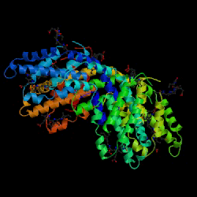
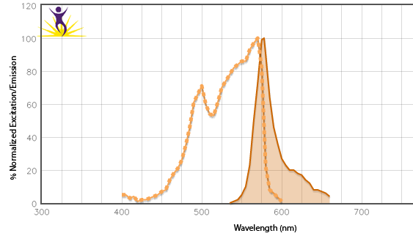
Phycobiliprotein: R-Phycoerythrin
Large multi-subunit, globular (~240 kDa) protein derived from red algae.
>20 chromophores per molecule
High quantum yield (bright)
Ex = 488 nm or 561 nm, Em = 575 nm
Why use PE?
High QY and EC make it an intense, efficient donor molecule for FRET.
Emission at 575 nm allows for longer wavelength utility (aka Stoke’s Shift).
®

