Slide 1
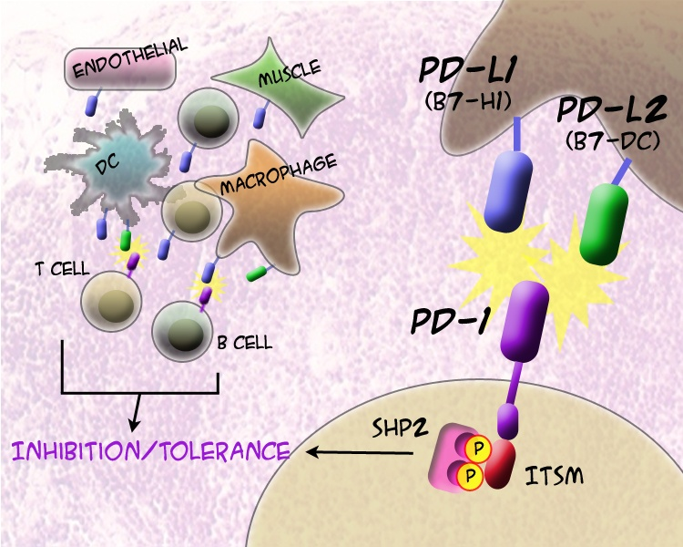
PD-1 and Ligands
®
Notes:
.

