Slide 1
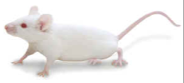
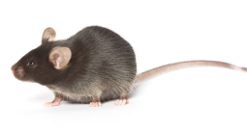
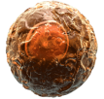
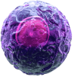
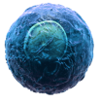
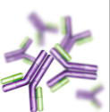
Anti-PD-1H Antibody Prevents Graft Versus Host Disease
Lethal Irradiation
Cells isolated from the bone marrow of a BALB/c mouse are transplanted into a lethally irradiated C57BL/6 mouse.
While Graft Versus Host Disease (GVHD) normally causes donor T cells to attack and kill a host, the treatment of host mice with a dose of anti-PD-1H antibody was sufficient to prevent GVHD.
Adapted from: Flies, D.B., et al. 2011. J. Immunol. 187: 1537.
Bone Marrow Derived Cells
BALB/c Mouse
C57BL/6 Mouse
Anti-PD-1H
Antibody (MH5A)
Graft Versus Host Disease
Death
®
Notes:
PD-1H is a newly discovered marker related to the CD28 family of molecules, also known as VISTA. It is a negative regulatory molecule that has found on macrphages, dendritic cells, neutrophils, NK cells, and T cells.

