Slide 1
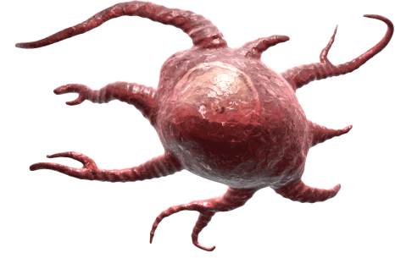
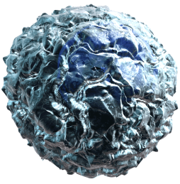
Plasmacytoid Dendritic Cells: Primers of Inflammation
Plasmacytoid Dendritic Cells
Dendritic Cells can often be divided into two subclasses: Plasmacytoid (pDC) and Conventional (cDC).
Brussel et al. showed that pDCs can stimulate cDCs to produce IL-12, which induces several cells of the immune system to produce IFNγ.
This promotes inflammation and can effectively limit viral infection or tumor growth.
Adapted from: Brussel, I.V., et al. 2012. Mediators Inflamm. Epub 2012 Jul 18.
CD40L
IFNα
CD40
Conventional Dendritic Cells
IL-12
NK Cells
Cytotoxic
CD8+ Cells
Th1 Cells
B Cells
IFNγ
Tumor and Virus-Infected Cell Death
®
Notes:
CD11c and MHC II is highly expressed on cDCs, while pDCs are phenotyped based on a combination of different markers (humans: CD303⁺ CD304⁺ CD123⁺; mouse: CD11c^{int} B220⁺ pDCA-1⁺ CD11b⁻).

