Slide 1
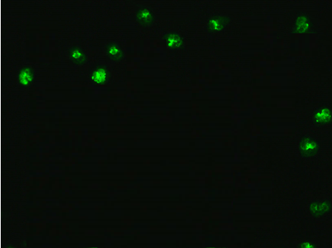
Immunohistochemistry
Chromogenic
Immunohistochemistry
Substrate
Enzyme-labeled 2° antibody
Target-specific
1° Antibody
Fluorescently-labeled
2° antibody
Immunofluorescent Immunohistochemistry
®

