Slide 1
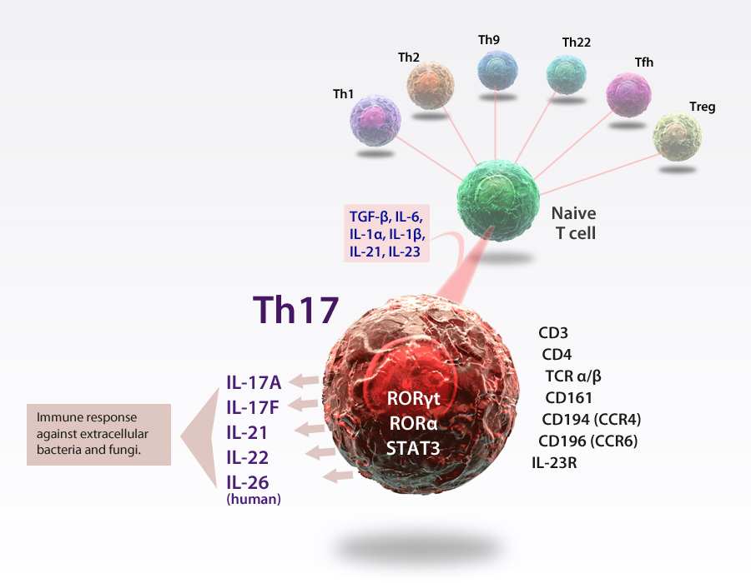
Th17 Cells
Th17 cells are a unique subset of activated T helper cells that normally provide anti-microbial immunity at epithelial and mucosal barriers. They are also implicated in a variety of autoimmune diseases, such as multiple sclerosis. Th17 cells are characterized by their expression of intracellular RORγt and STAT3 and production of cytokines: IL-17A, IL-17F, IL-21 and IL-22. In humans, they can be identified using cell surface markers for CD4, CD161 and CCR6.
®

