Slide 1
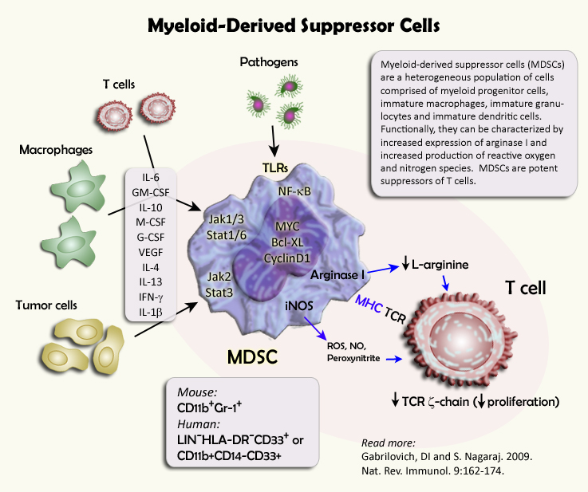
Myeloid-Derived Suppressor Cells
®
Notes:
.

