Slide 1
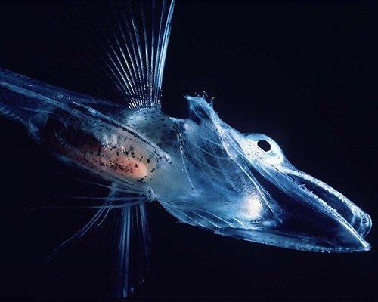
Lectins and C-type Lectins
Lectins are proteins that recognize glycosylation events. They are often highly specific, recognizing individual sugar moieties. Lectin functions include:
Protein folding
Cell-cell interaction
Removal of certain glycoproteins from circulation.
Immune recognition of pathogen-specific carbohydrates (Lectin Complement Activation, Mannose-Binding Lectin)
A special class of lectins called C-type lectins bind to proteins, lipids, inorganic molecules (e.g., Ca₂CO₃), or even ice (anti-freeze glycoproteins). Glycan binding by the C-type lectins is always Calcium-dependent (hence the name) because of specific amino acid residues that coordinate Calcium and bind the hydroxyl groups of sugars.
Crocodile Icefish: No ice in its veins thanks to anti-freeze glycoproteins.
®

