Slide 1
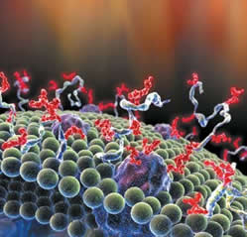
Glycosylation Overview
The post-translational attachment of a carbohydrate (sugar subunits) to proteins and lipids. Roughly half of all proteins undergo this modification.
Glycosylated proteins (glycoproteins) can be found in almost all living organisms (eukaryotes, eubacteria, and archea).
Functions include:
Cell attachment to the extracellular matrix
Protein folding in endoplasmic reticulum, protein interaction (Large, bulky sugar additions affect how proteins interact).
Protein Solubility (these events can be hydrophilic).
®

