Slide 1
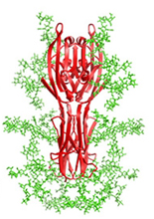
Glycosylation Events and Types
Glycosylation can depend on:
Enzyme availability: enzymes can exist in gradients or be sequestered in particular compartments.
Amino acid sequence: the proper amino acids or motifs must be recognized.
Protein conformation: some amino acids are hidden due to the structure of the protein.
Type | Attachment Site | Notes
N-Linked | Glycan bind to the amino group of asparagine in the ER | The most common form of glycosylation.
O-Linked | Monosaccharides bind to the hydroxyl group of serine or threonine in the ER, Golgi, cystosol and nucleus | Essential for biosynthesis of mucins and mucus secretions. Antibodies are often heavily O-glycosylated.
Glypiation | Glycan core links a phospholipid and a protein | This target localizes proteins/lipids to the cell membrane.
C-Linked | Mannose binds to the indole ring of tryptophan | Its function is currently unknown.
Phosphoglycosylation | Glycan binds to serine via phosphodiester bond | Mainly found in slime molds and unicellular parasites.
®

