Slide 1
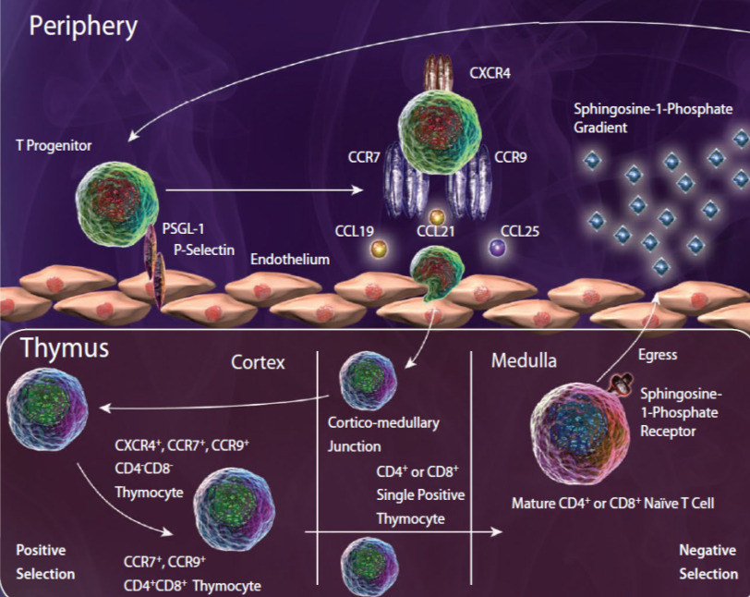
Chemokine Dependent Entry into the Thymus
Bone Marrow
T cell progenitors migrate from the bone marrow (or fetal liver) to the thymus based on chemokine receptor expression.
The expression of CCR7, CCR9, and CXCR4 are vital for T cell progenitor entry into the thymus, as deficiencies in any of these receptors, particularly CCR9, leads to a drastic reduction in thymal T cell populations and colonization.
Adapted from: Calderón, L. and Boehm, T. 2011. PNAS. 108:7517.
®
Notes:
While T cells develop in the thymus, there are no hematopoietic cells present here, indicating progenitors must arrive from elsewhere. The receptors are listed with their corresponding ligands here: CCR7-CCL19, CCL21; CCR9-CCL25; CXCR4-CXCL12.

