Slide 1
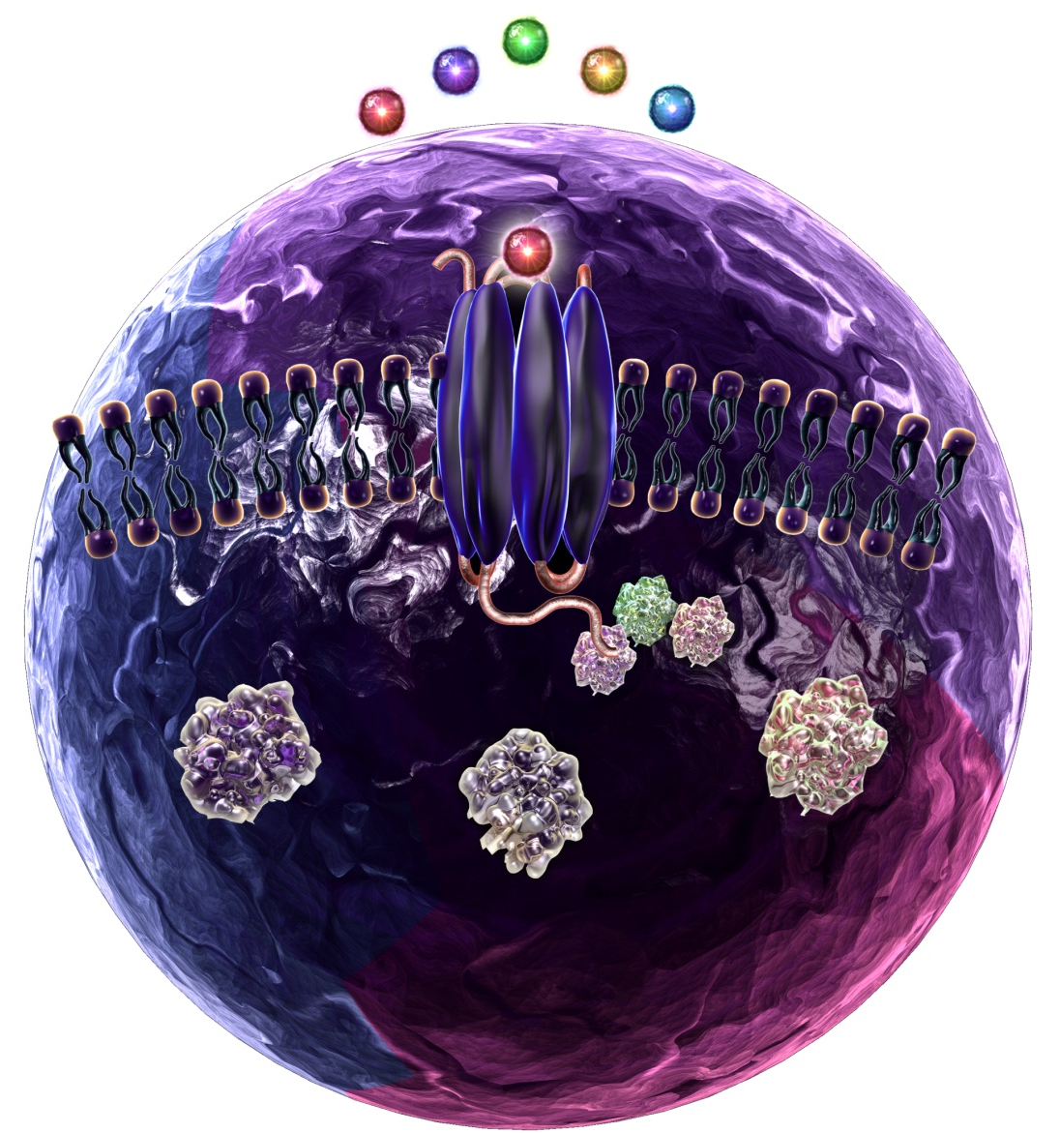
Getting Acquainted with CCR3
CCR3 (CD193) has several ligands: Eotaxin, Eotaxin-3, MCP-3, MCP-4, and RANTES.
CCR3 is expressed by eosinophils, basophils, mast cells, mononuclear phagocytes, platelets, keratinocytes, and Th2 cells.
CCR3 functions include chemotaxis, inflammation, reactive oxygen species release, and stress fiber formation.
CCR3 has been found to be involved with allergic airway responses, ulcerative-colitis, and HIV infection.
RANTES
Eotaxin-3
MCP-3
Eotaxin
MCP-4
CCR3
Extracellular
Membrane
Intracellular
G Proteins
PI3Kγ,
RAS
RAC,
p38
PLCβ,
PIP2
Reactive
Oxygen
Species
Stress Fiber
Formation
Chemotaxis,
Inflammation
®
Notes:
Eotaxin (CCL11); Eotaxin-3 (CCL26); MCP-3 (CCL7); MCP-4 (CCL13); RANTES (CCL5).

