Slide 1
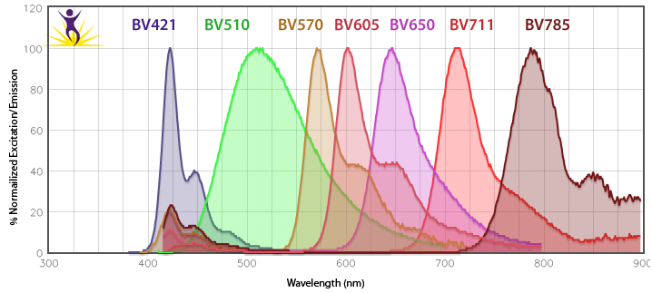
Brilliant Violet™ Fluorophores
Brilliant Violet™ fluorophores are long polymer chains composed of highly efficient, fluorescent units.
Light harvesting
Large absorption cross-section
Emission spectra of the Brilliant Violet™ fluorophores
®

